Slide 1


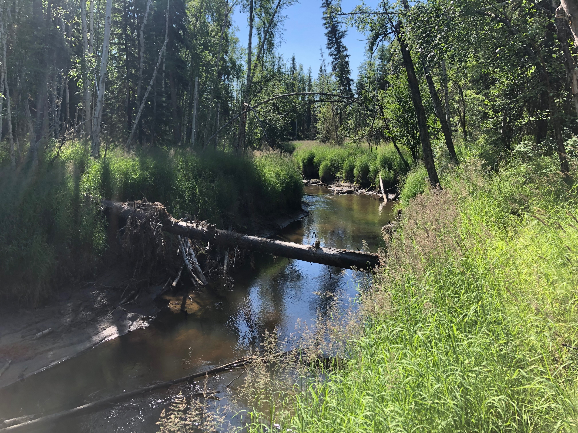

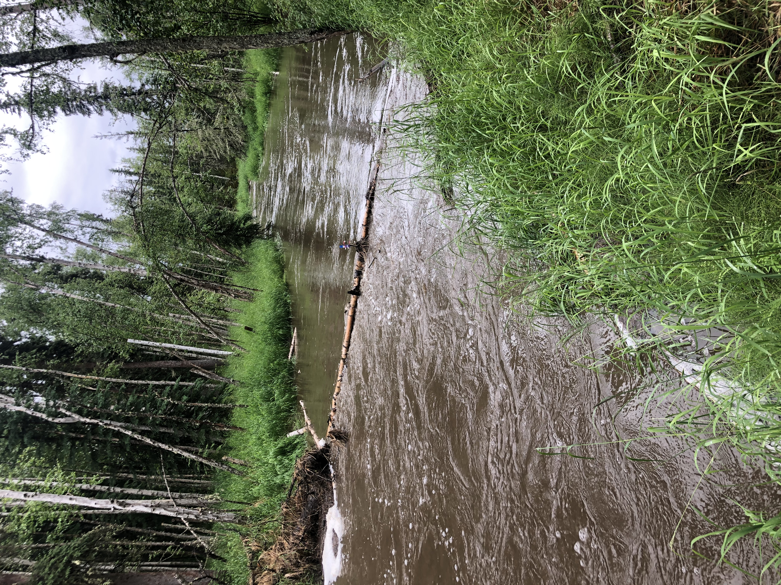
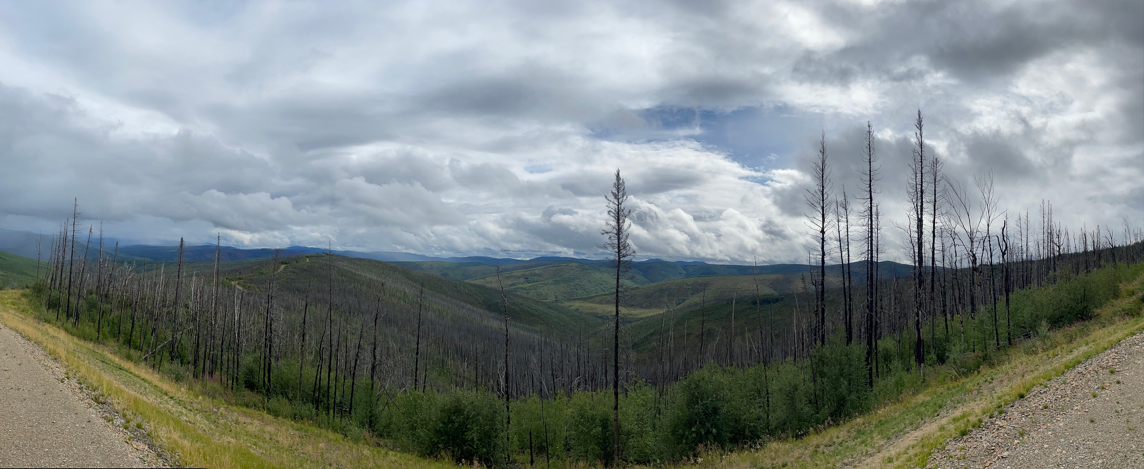
B45J-1750
Role of Antecedent Moisture Conditions on High-Latitude Biogeochemistry
Jake S. Cavaiani¹, Tamara K. Harms¹, Jeffrey Falke², Thomas Douglas³
¹Intitute of Arctic Biology, University of Alaska Fairbanks, ²U.S. Geological Survey, Alaska Cooperative Fish and Wildlife Research Unit, University of Alaska Fairbanks, ³U.S. Army Cold Regions Research & Engineering Laboratory
How does increased temporal variability in precipitation alter catchment biogeochemistry in high-latitude catchments?
Stream solute concentrations and discharge across 2019 and 2020
HI at a storm-scale correlates with antecedent moisture conditions rather than storm characteristics
R² =0.11
R² =0.14
Increases in rainfall are correlated with increases in active layer depth and permafrost thaw
Hydrologic flowpaths shift from shallow organic rich soils to deeper, mineral rich soils
R² =0.01
R² =0.23
Hypothesis: Precipitation promotes solute uptake and leaching, thereby reducing solute storage within catchments and potential for subsequent export
Stream concentrations of NO₃⁻, fDOM were not significantly different from 2019 and 2020
R² =0.35
R² =0.04
Total precipitation from 2010-2021
French Moose Poker Stuart Vault
High-frequency stream chemistry monitoring
Mod PF
Mod PF
Low PF
High PF
High PF
R² =0.06
R² =0.29
In situ sensors collecting fluorescent dissolved organic matter (fDOM, proxy for dissolved organic carbon) and nitrate (NO₃⁻) concentrations in 2019-2020 in boreal catchments at 15 minute intervals
Sites consisted of varying permafrost extent, fire history and aspect
North-facing slopes are dominated by black spruce whereas south and west-facing slopes are dominated by mixed hardwoods
Calculating Hysteresis and Beta Indices
Hysteresis: Differences in the concentration-discharge relationship between the rising and falling limbs of a storm indicating transport vs. storage limitation
Beta: C-Q slope of the rising limb to indicate flushing or dilution
Little evidence of storm-scale patterns across PF extent for fDOM
Switch from flushing to diluting throughout the season for NO₃⁻
R² =0.01
R² =0.22
Left: Five study sites of interest. Moose Creek (moderate PF extent) during baseflow and during storm event
Clockwise, dilution
Clockwise, flushing
Clockwise, dilution
Clockwise, flushing
Left: HI and beta for individual storms in each catchment for 2019 and 2020
Anti-clockwise, dilution
Anti-clockwise, flushing
Anti-clockwise, dilution
Anti-clockwise, flushing
Storm characteristics such as total storm precipitation and intensity do not correlate with HI
Varying temporal antecedent moisture conditions influence HI across catchments
Antecedent conditions have ecological and management implications in high-latitude catchments
Acknowledments: Thomas Douglas, Jeffrey Falke, Laura Knutsen, Justin Hill, Kate Broberg, Dragos Vas, Tricia Nelsen, Lauren Bosche and Steph Saari contributed to sample collection and analysis. Research was supported by the Bonanza Creek Long-Term Ecological Research program (funded jointly by NSF grant DEB-1026415 and USDA Forest Service, Pacific Northwest Research Station grant PNW01-JV-11261952-231 and Development Program of the Department of Defense (RC-2507)
Poker Creek (low PF extent) displays sustained elevated concentration of NO₃⁻ triggered by storm events
Stuart Creek (high PF extent) displays flushing of fDOM during storms
Jcavaiani@alaska.edu

